Slide 1


Titolo presentazione sottotitolo
F10. Template Matching in Depth Images
Milano, XX mese 20XX
Corti Greta - Chiari Giuseppe - Shalby Hazem

Slide 2
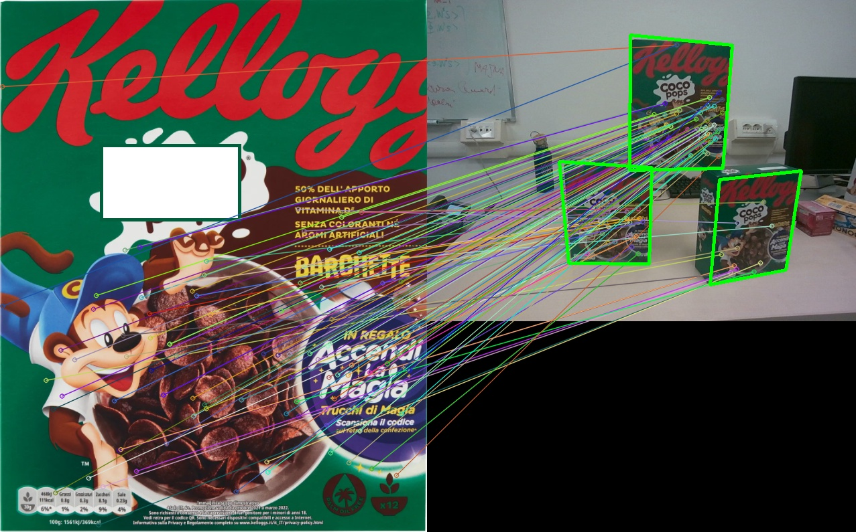
Project Formulation
Template matching is a very practical technique for finding all the occurrences of a known target in a given query image.
The goal of this project is to expand a template detection pipeline using RGB-D data.
In this project the main goal is to recognize squared boxes of supermarket products.

Slide 3

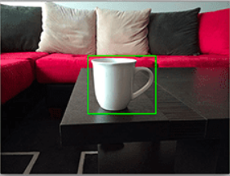

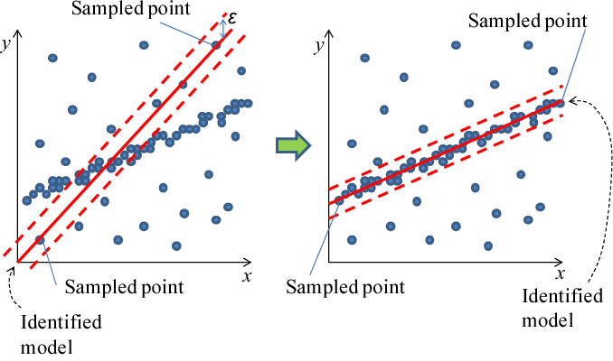
State of the art
Template
Feature detection
+
Descriptor computation
(SIFT, ORB, SURF)
RANSAC
Scene

Slide 4
Solution approach
Approaches proposed tackles keypoints filtering:
Canny Filter Method
and keypoints selection to fit an homography:
customFindHomographyDimension
customFindHomographyRectangles

Slide 5
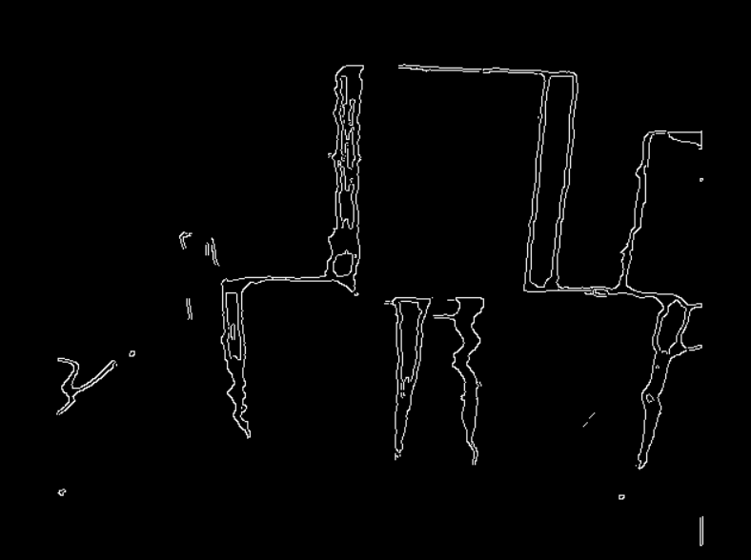
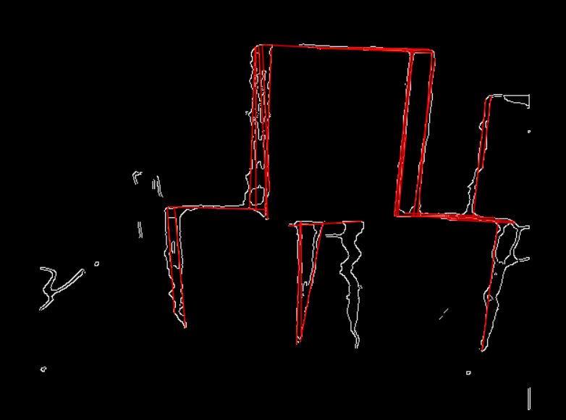
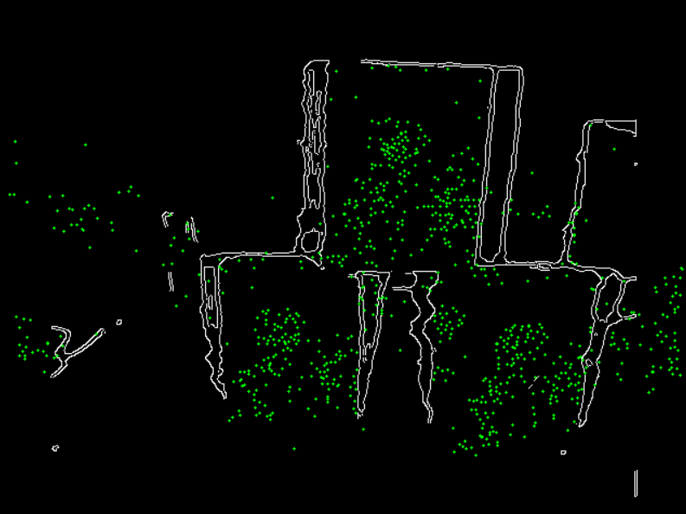
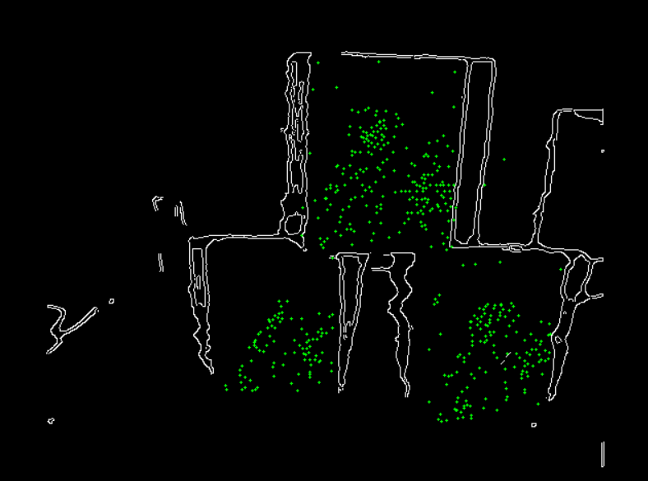
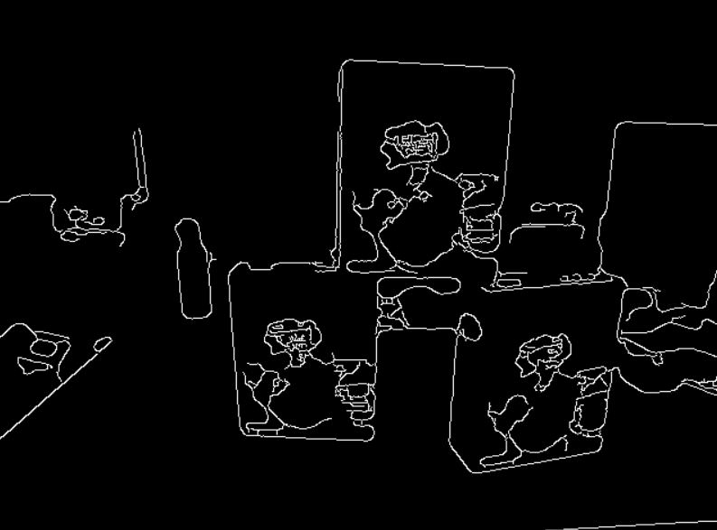
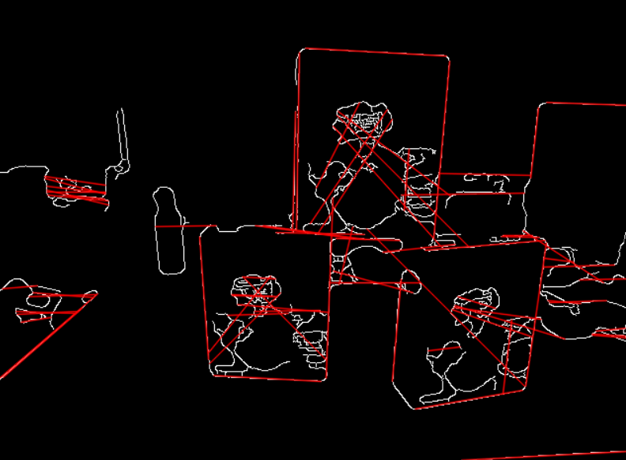
Canny Filter Method
Depth Image
Initial key points
Final key points
2. Probabilistic Hough Line Transform
1. Canny edge detector
Scene Image

Slide 6
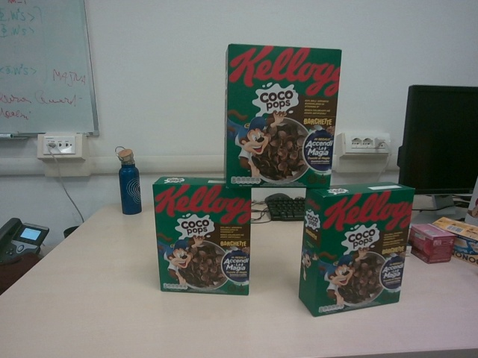
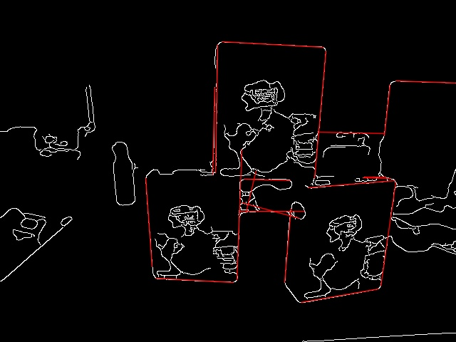
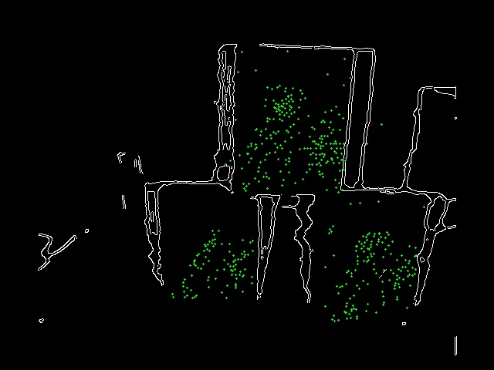
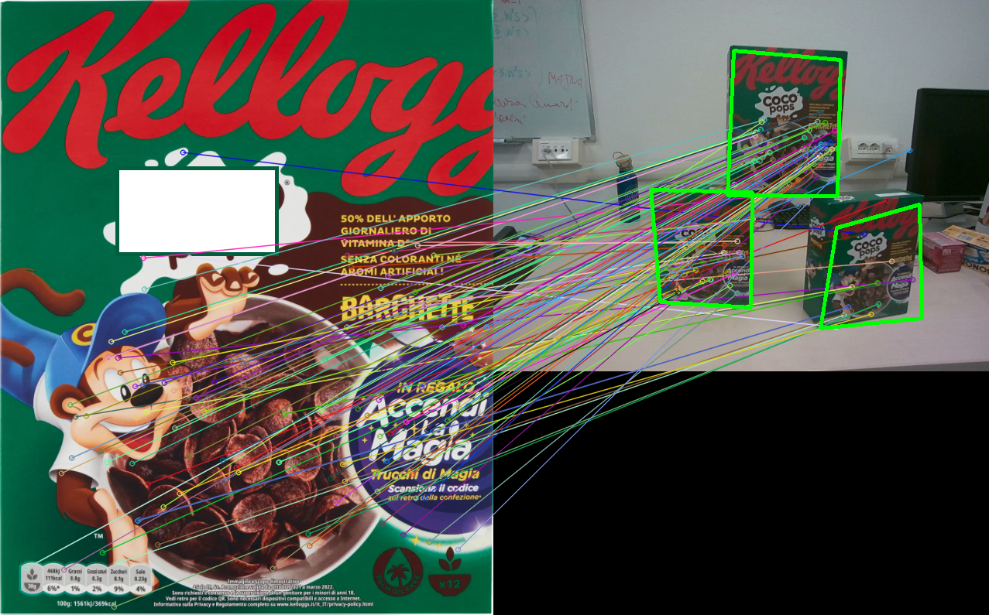
Homography based on boxes dimensions
1.Image acquisition
2.Lines detection
3.Filtering
4.Dimension acquisition
6.Final result
"barchette": {
"width": 0.192,
"height": 0.241,
"depth": 0.061
}
5.Fit the homogrophy

Slide 7
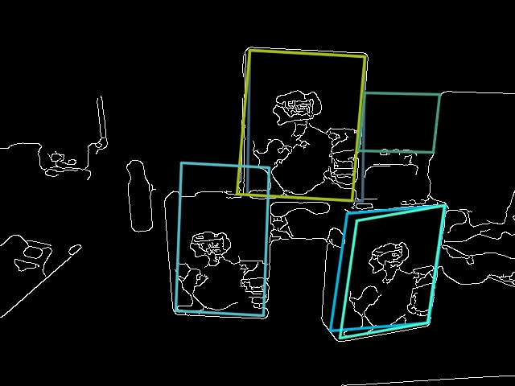
Homography based on Rectangles
1.Image acquisition
2.Lines detection
3.Rectangles detection
4.Filtering
6.Final result
5.Fit the homogrophy

Slide 8
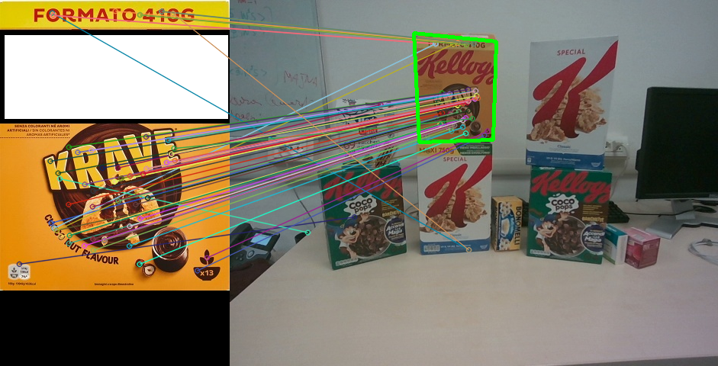
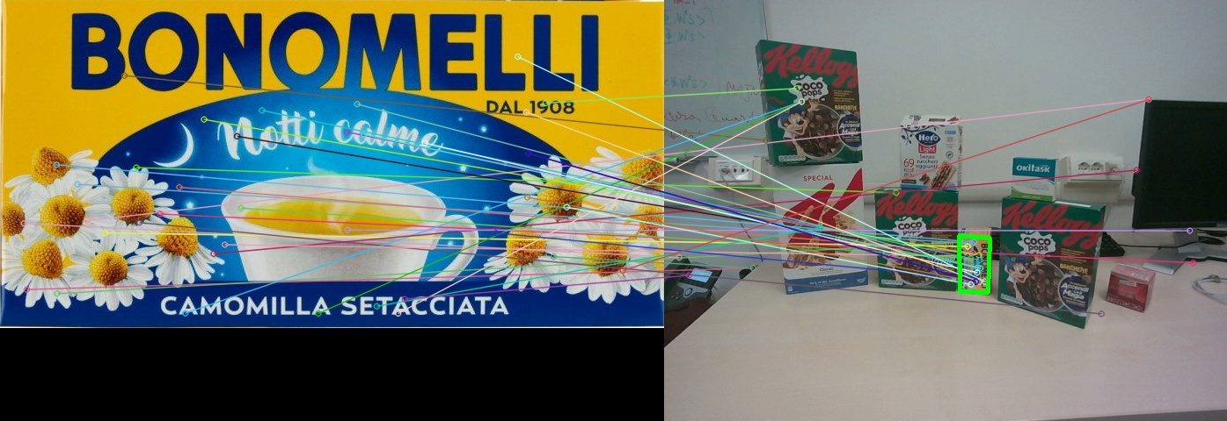
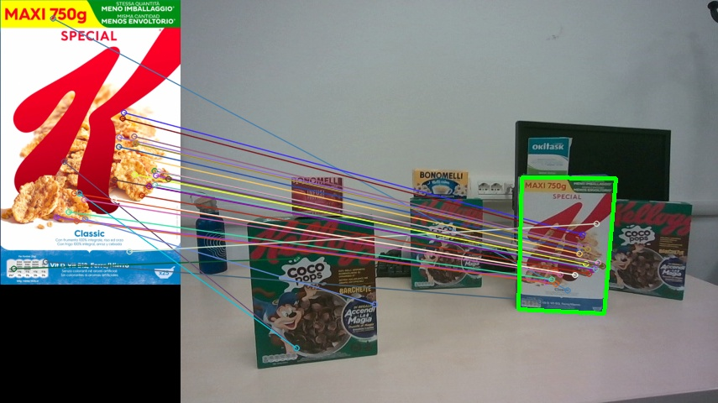
Experiments
customFindHomographyDimension
with filter, image 3, krave template
customFindHomographyDimension
without filter, image 2, camomilla template
customFindHomographyRectangles, image avanti_dietro2, classic template

Slide 9
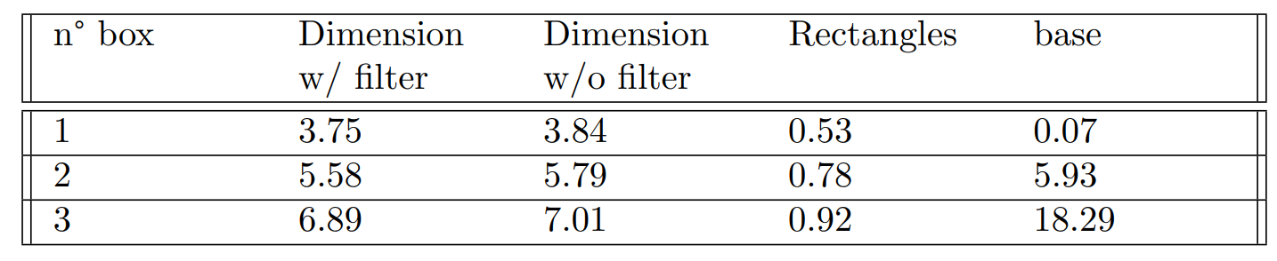
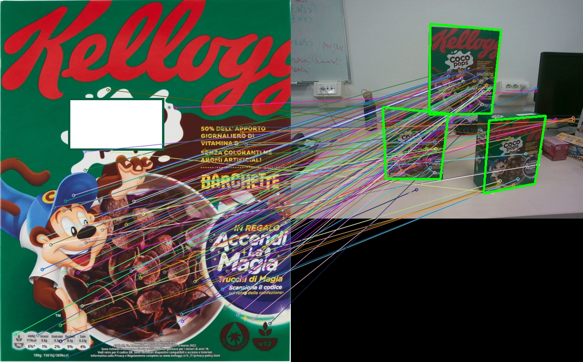
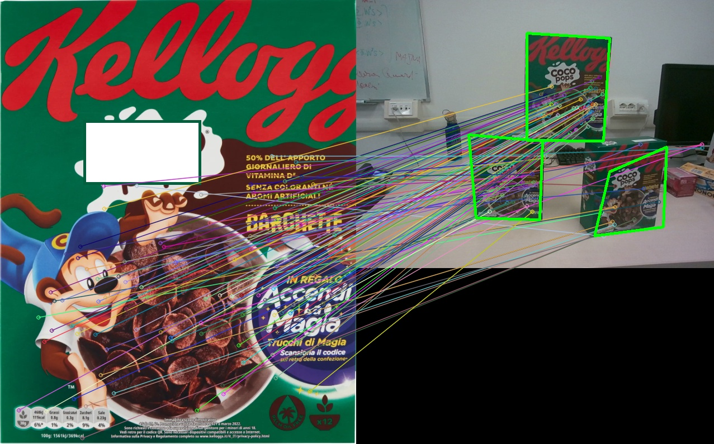

Results

Slide 10
Conclusion and Open problems
The number of key points decreases by one-third of the initial total number using the canny filter method
customFindHomographyRectangles can outperform drastically the other methods maintaining the same precision
customFindHomographyDimension (with or without filter) is more consistent, but it is slower
Improve the rectangle identification
Remove degenerate bounding box
Problem due to randomization

